Slide 1
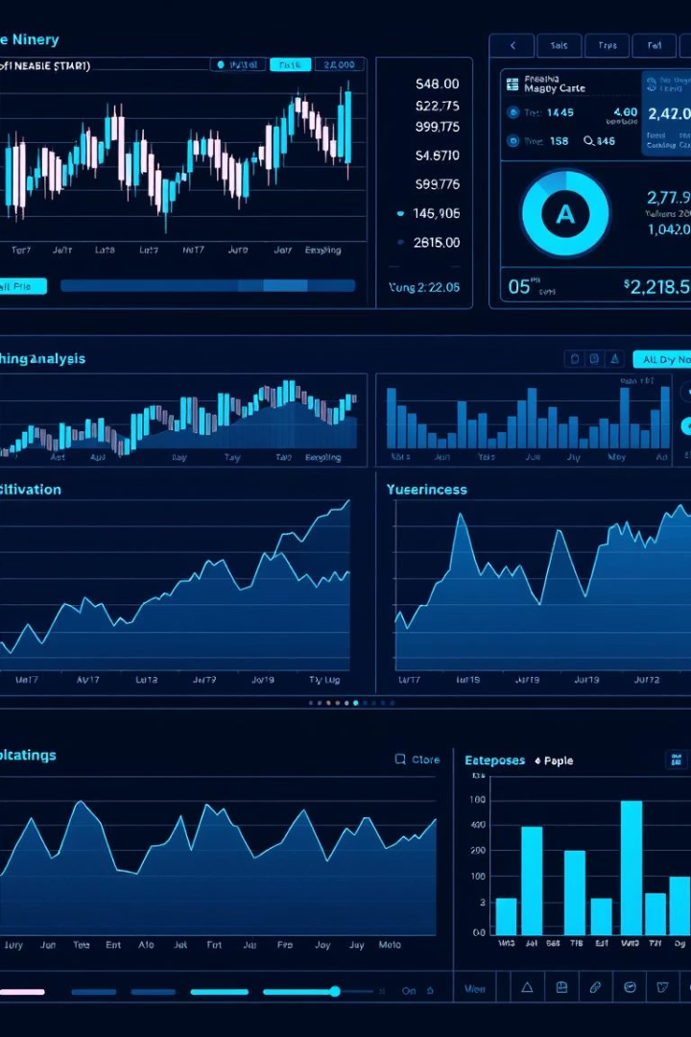

Foundational Project
Stock Forecasting CRISP-ML(Q) Framework Implementation
This project forecasts Nifty 50 stock returns over 3-month, 6-month, and 1-year periods. By integrating fundamental, technical, and sector-performance data, we provide insights for investors with varied time horizons. An interactive web application enhances portfolio analysis and exploration.
Project By
1
Kanishk
2
Aashish
3
Priyesh
4
Suraj

Slide 2

Business & Data Understanding
Problem Framing
We tailored forecasting horizons to investor needs: 1 year, 6 months, and 3 months. Our predict_stock() function automates data download, feature creation, prediction, and explanation.
Success Criteria
We measure directional accuracy, RMSE, MAPE, and portfolio backtest returns, displayed in the Model Performance and Portfolio Analyzer pages.

Slide 3




Data Collection & Quality Verification
Data Sources
Price and volume data from yfinance.download(); fundamentals from yfinance.Ticker.info.
Sentiment Placeholder
News sentiment scoring via VADER is prepared but scraping is stubbed.
Data Quality
Minimum 100 days of records enforced; fallback between NSE/BSE; NaNs dropped after merging for clean inputs.

Slide 4


Data Preparation
Feature Engineering
Fundamentals & Scaling
Moving averages (50 & 200 days) and their ratios
Market cap, P/E, ROE, debt ratios, quarterly revenue/profit
Volatility and returns over multiple windows
Momentum and volume metrics
Future return target shifted 365 days ahead
StandardScaler applied on training data and test sets

Slide 5

Modeling: Design & Development
Model Strategy
1
Combined Random Forest for nonlinear patterns and Linear Regression for stability, averaging predictions for long-term forecasting.
Explainability
2
Used SHAP values for global and local interpretability, enhancing trust in model outputs.
Reproducibility
3
Walk-forward splits, fixed random seeds, and Git tracking ensure consistent retraining and deployment.

Slide 6




Evaluation & Metrics
Directional Accuracy
Accuracy Metrics
Measures correct up/down predictions, crucial for investment decisions.
RMSE, MAPE, and R² assess magnitude and overall fit.
1
2
Return Analysis
Model Insights
4
3
Average returns on positive predictions compared against benchmarks.
SHAP summary plots highlight top global feature impacts.

Slide 7

Deployment Plan
Backend & Frontend
App Structure
Four pages: Stock Predictor, Portfolio Analyzer, Model Performance, and About with version info.
Python model with scikit-learn and yfinance; Streamlit app for interactive UI with custom dark theme.
Configuration
Streamlit page config and CSS customization enable smooth user experience.

Slide 8
Architecture: The model is built with a Python backend (scikit-learn, yfinance). The user interface and visualizations are created using Streamlit (streamlit_app.py), and the application is hosted on Streamlit Cloud.
Functionality: The app provides stock predictions (model.predict_stock()) with Buy/Hold/Sell recommendations, visualizes indicators (moving averages, SHAP factors), and will offer a downloadable summary PDF in the future.
User Feedback: The application features a custom CSS dark theme and iterative UI improvements based on user feedback, including adjustments to font sizes and colors. Personalized dashboards are planned as a future enhancement.
Risk Controls: Visual confidence intervals (±15% prediction range) and a model freshness check (last_updated timestamp) are implemented to manage and display risk.
That concludes our deployment overview.

Slide 9
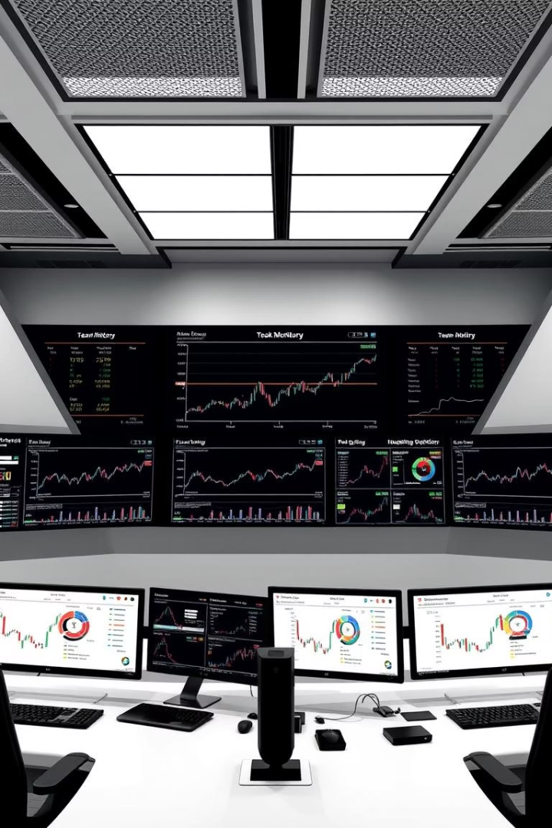
Monitoring & Maintenance
Versioning & Updates
Drift Detection
Pipeline supports drift checks and auto-retraining triggers based on evaluation metrics.
App displays version and last-updated timestamp for transparency.
Reproducibility
Git tracking and fixed requirements enable new team members to replicate environment and run the app seamlessly.

Slide 10

Technical Stack & Success Factors
Tech Stack
Key Enablers
Data: pandas and yfinance for time-series data and fundamentals
Persona-driven design and well-defined success metrics
Models: scikit-learn (Random Forest & Logistic Regression), XGBoost, statsmodels
Rapid MVP development and early feedback integration
Reproducible, git-tracked experiments with SHAP visualizations
NLP: VADER, transitioning to FinBERT for sentiment analysis
Simple, intuitive UI with in-app feedback mechanisms
Viz: Streamlit UI and Plotly charts for interactive visualizations
Hosting: Streamlit Cloud with auto-deploy functionality
Future Enhancements
Integration of live social media sentiment analysis
Broker API integration for one-click trading
Automated benchmarking against ARIMA/GARCH models
Real-time alerts and a notification center

